Slide 1

Unleashing the Power of AutoML
Gerald Friedland
UC Berkeley, Amazon Web Services
Debanjan Datta
Amazon Web Services

Slide 2

Introduction
What is AutoML?

Slide 3
AutoML
AutoML is defined as a set of methods and processes that are designed to make Machine Learning accessible in a useful but efficient manner for non-Machine Learning experts so that ML can be leveraged for their tasks.

Slide 4
Abstracting Complexity
Notes:
We take an approach of performing a practical exercise of building a ML system from scratch.
We want to show how different components need to be set up and correctly synchronized.

Slide 5
Introduction
Implementing ML system starts with:
Selecting and Provisioning a machine
Setting up an environment
Multimedia applications require Deep Learning
Specific hardware viz. Cudahy enabled GPU
Correct Libraries
Correct development environment settings
Notes:
There are multiple steps to setting up a ML system
a key challenge is selecting the correct hardware – either local or virtual
Most multimedia applications require deep learning --- which is accelerated by the use of GPUs. specifically Cudahy enabled GPU.
While this might be common knowledge to ML practitioners --- this introduces several complexities.

Slide 6

Practicum: Set up the environment
https://github.com/ddatta-DAC/ACM_MM_2024_Tutorial
Full Setup
Quick set up
Jupyter Lab
Notes:
`NVidias` helps us check the resources.

Slide 7
Problem Statement
Images : Key modality in multimedia
Related ML problem : Image Classification
Question: How does AutoML help simplify the solution ?
Abstraction of Complexity

Slide 8
Practicum: Download Data
CIFAR-10 dataset
Simple to understand
Public
We use a subsample (for ease of demonstration)
Notebook

Slide 9
Practicum
A approach in AutoML: Transfer Learning
Pre-trained models can be finetuned on target datasets
Sot performance
Less computationally expensive
We train a Image classification model
Architecture: ResMed
Train only the final layer of the neural network
Code

Slide 10
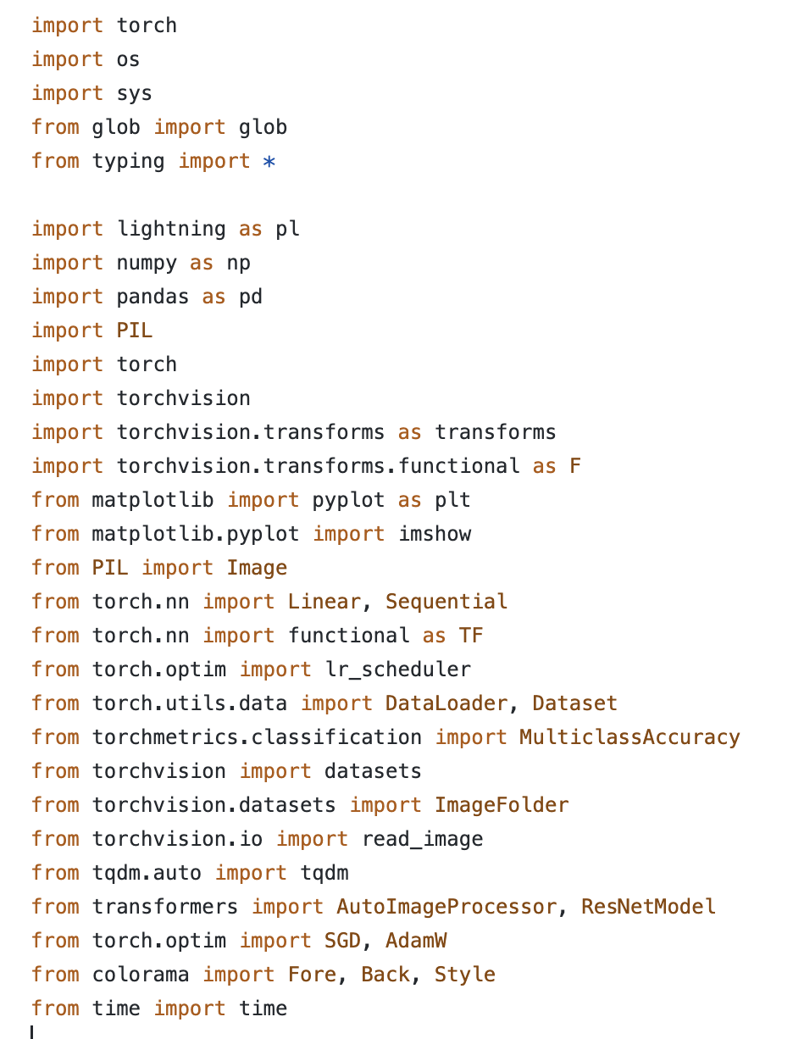
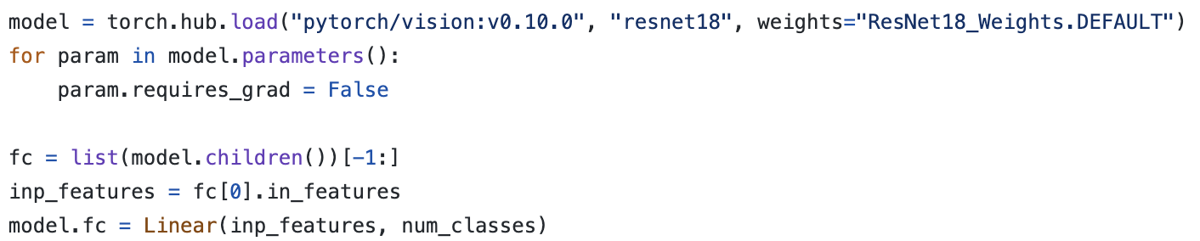
Complexity
Importing correct libraries & dependencies
Obtaining correct model weights

Slide 11
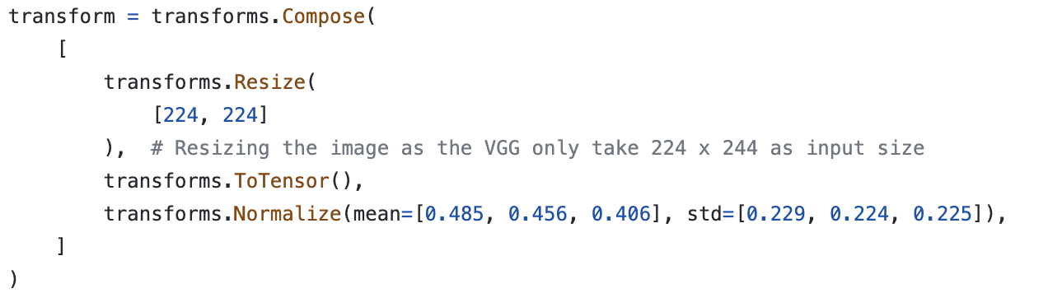
Complexity
Model & dataset specific transforms
Converting data to ML library compatible format e.g. tensors
Notes:
So the user is in charge of training the model, with the optimization process and associated steps, hyperparameters.
Additionally, which model to use.

Slide 12
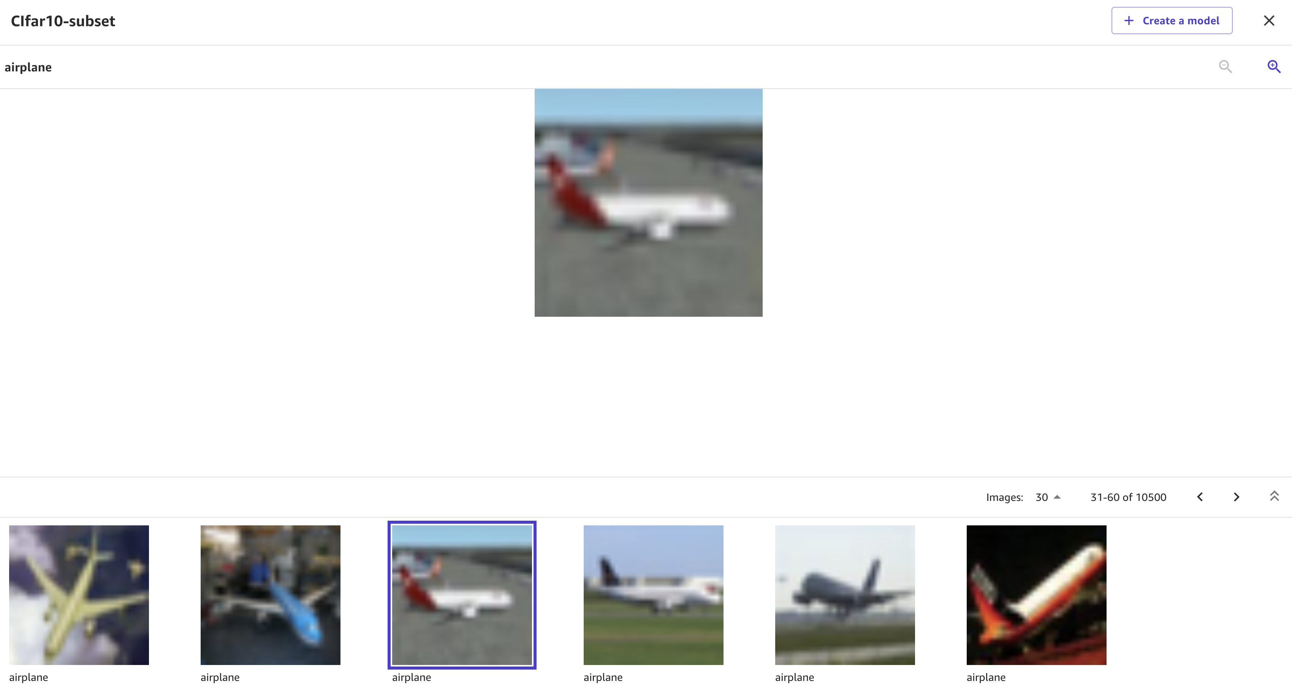
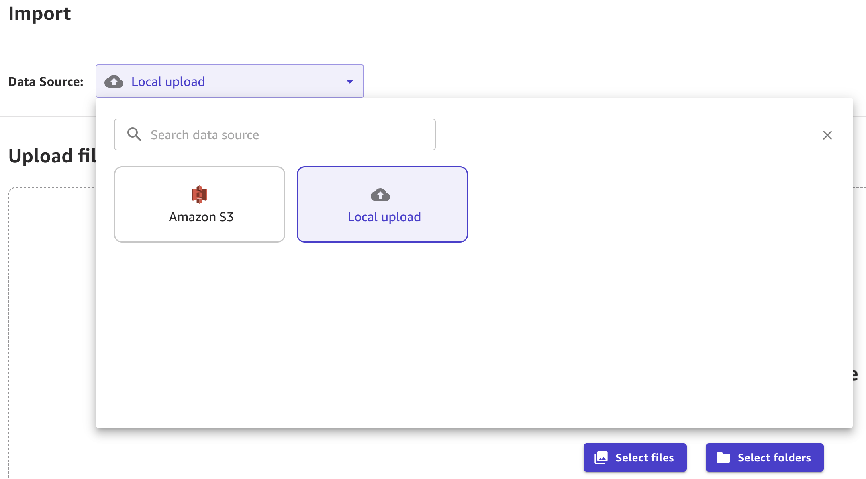
AutoML with AWS SageMaker Canvas
Create dataset
Import from a local source
Import from Amazon S3
Notes:
AutoML brings to table a solution that reduces complexity

Slide 13
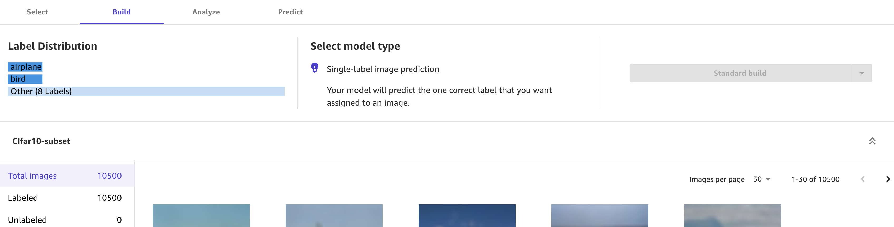
AutoML with AWS SageMaker Canvas
Visualize the data distribution of labels.
Select type of model to be built:
Quick Build
Standard Build

Slide 14
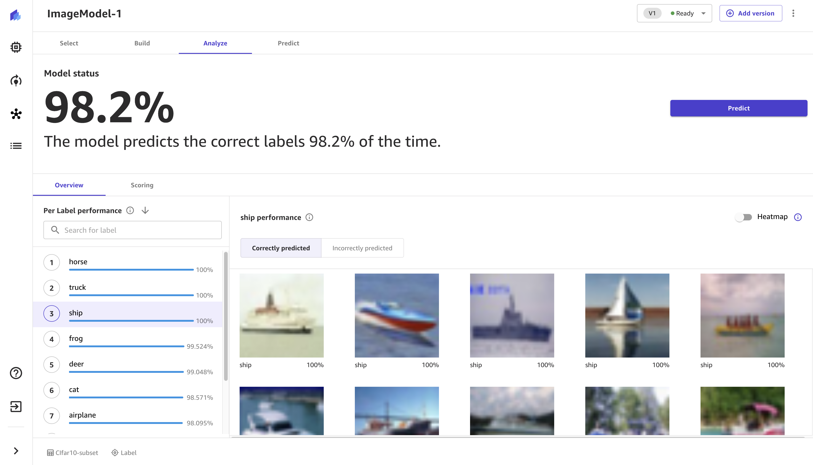
AutoML with AWS SageMaker Canvas
Single click and the model is built!

Slide 15
Takeaways
Demonstrate the complexity:
Loading data, formatting data
Applying transforms
Implementing training from scratch
Setting training hyper-parameters
AutoML reduces complexity leading to a cleaner solution!

Slide 16
Hyperparameter & Model Selection

Slide 17
Introduction
Hyperparameters --- key to ML model performance
Controls the learning process
Not Learnt --- unlike parameters of a ML model
Needs to be explicitly by user
Affects the outcome significantly

Slide 18
Hyperparameters
Difficult to estimate correct values
Different combinations of hyperparameter
Different hyperparameter ranges, types
Possibly exponential search space
Hyperparameters should account for hardware
Rule of thumb values are not adequate

Slide 19
Problem Statement
A key multimedia modality --- Text
Related ML problem : Text Classification
Question : How does AutoML simplifies the solution ?
Model selection & Hyperparameter settings

Slide 20
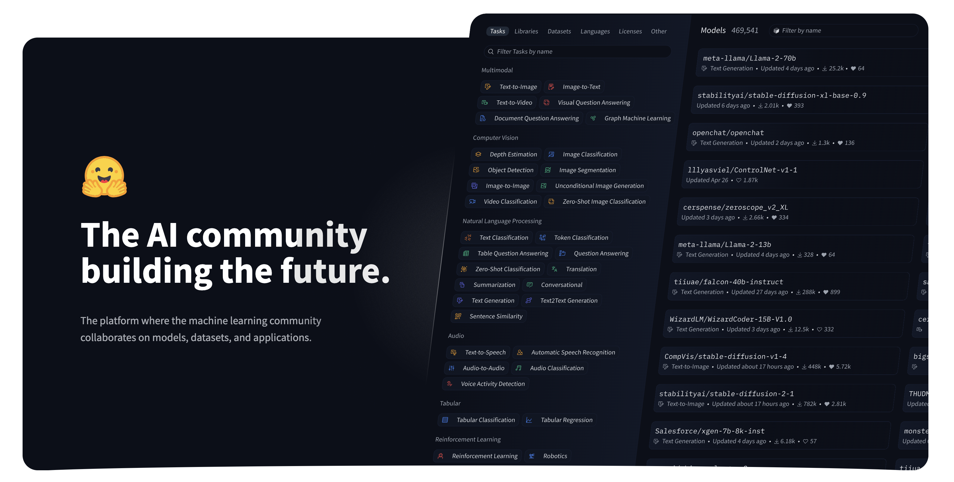
Problem Statement
Open source ML solutions : Huggingface
Comparatively simple:
Experiment with models
Python Libraries with documentation
Notes:
Open ML solutions have made it easier for users to experiment with SoTA models.
Huggingface is one of the most prominent ones.

Slide 21
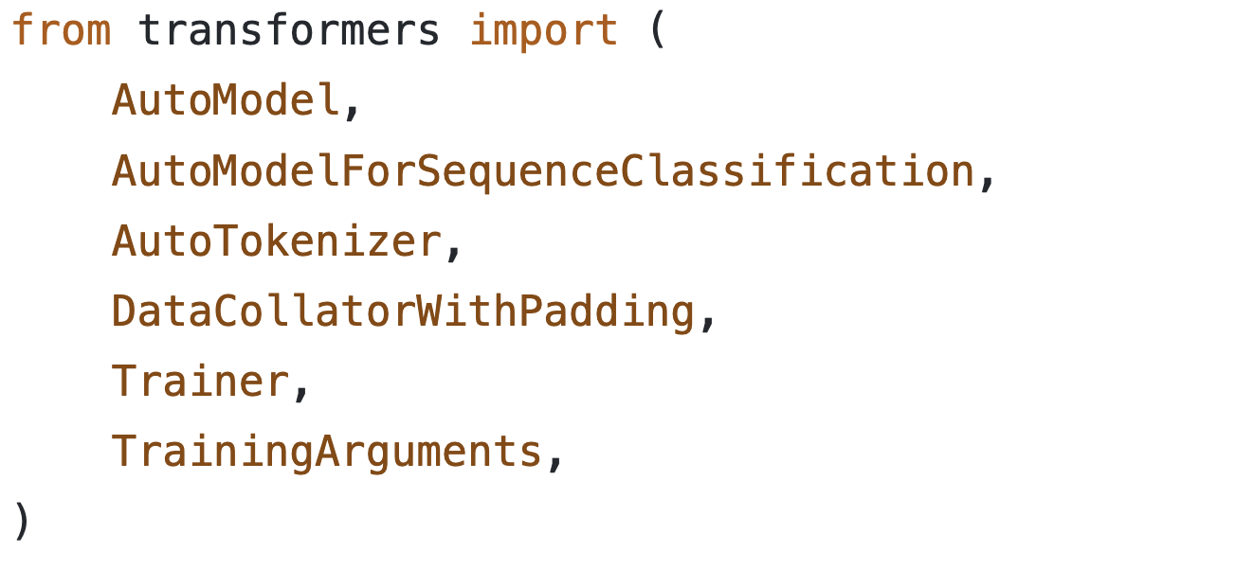
Practicum
Data:
IMDB Reviews (Open source)
Github Link to for data pre-processing and exploration
Perform Text Classification in Python, using ML Libraries
Huggingface transformers
Code

Slide 22
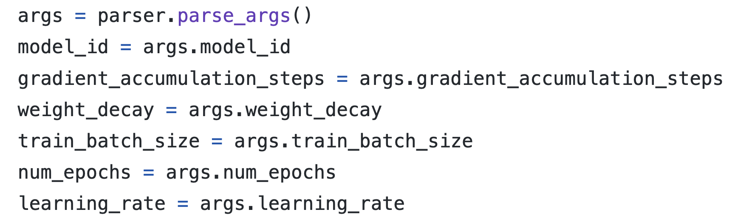
Practicum : Effect of Hyperparameters
Models takes a set of hyperparameters
`model_id` : Model

Slide 23
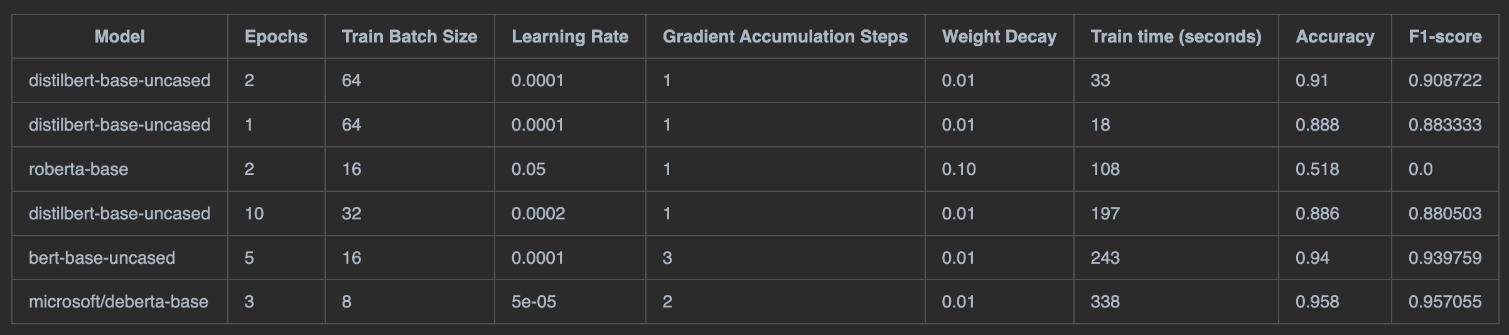
Practicum: Experiment 1
Experiment & Results

Slide 24
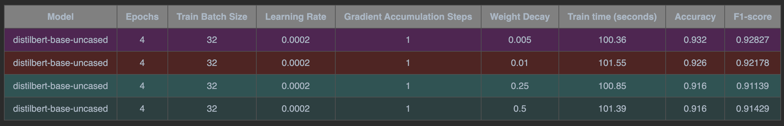
Practicum: Experiment 2
Experiments & Results

Slide 25
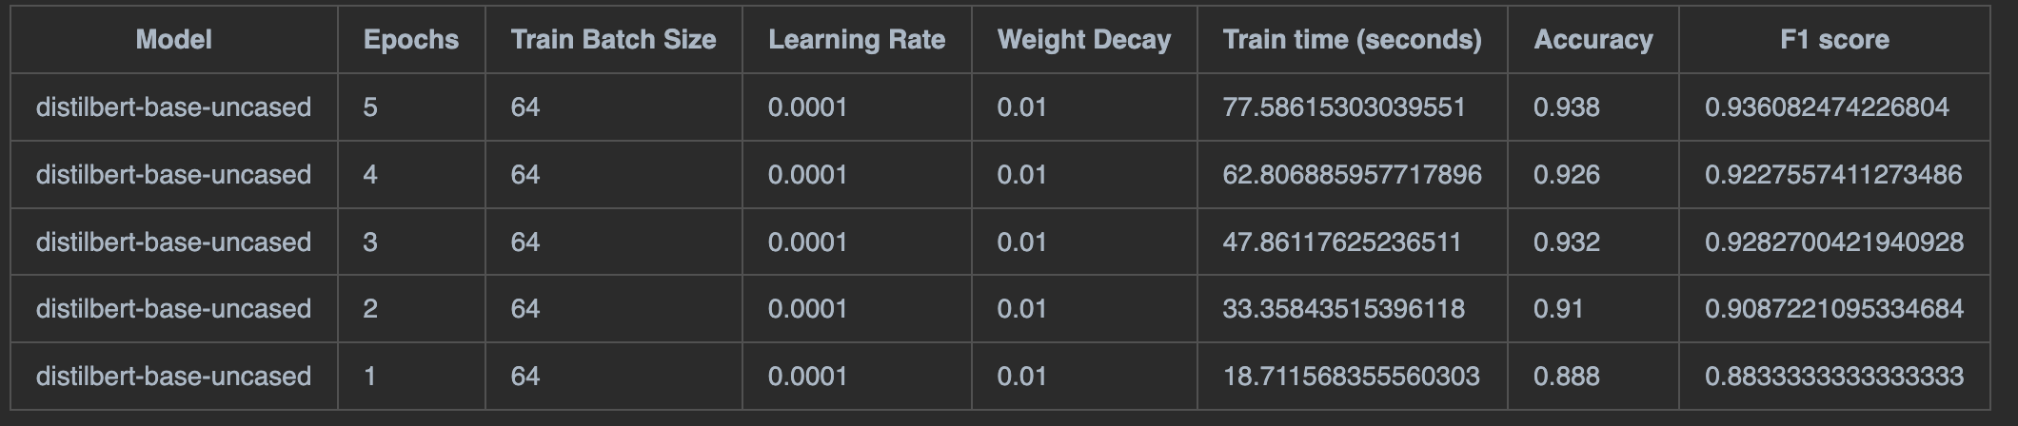
Practicum: Experiment 3
Experiments & Results

Slide 26
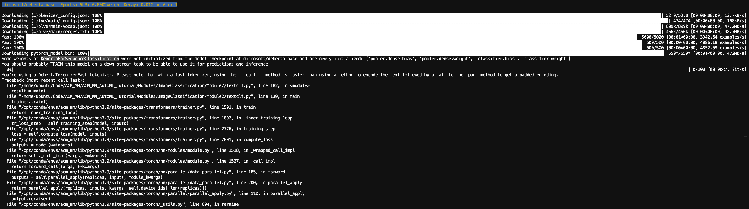
Practicum: Experiment 4
Experiments & Results

Slide 27
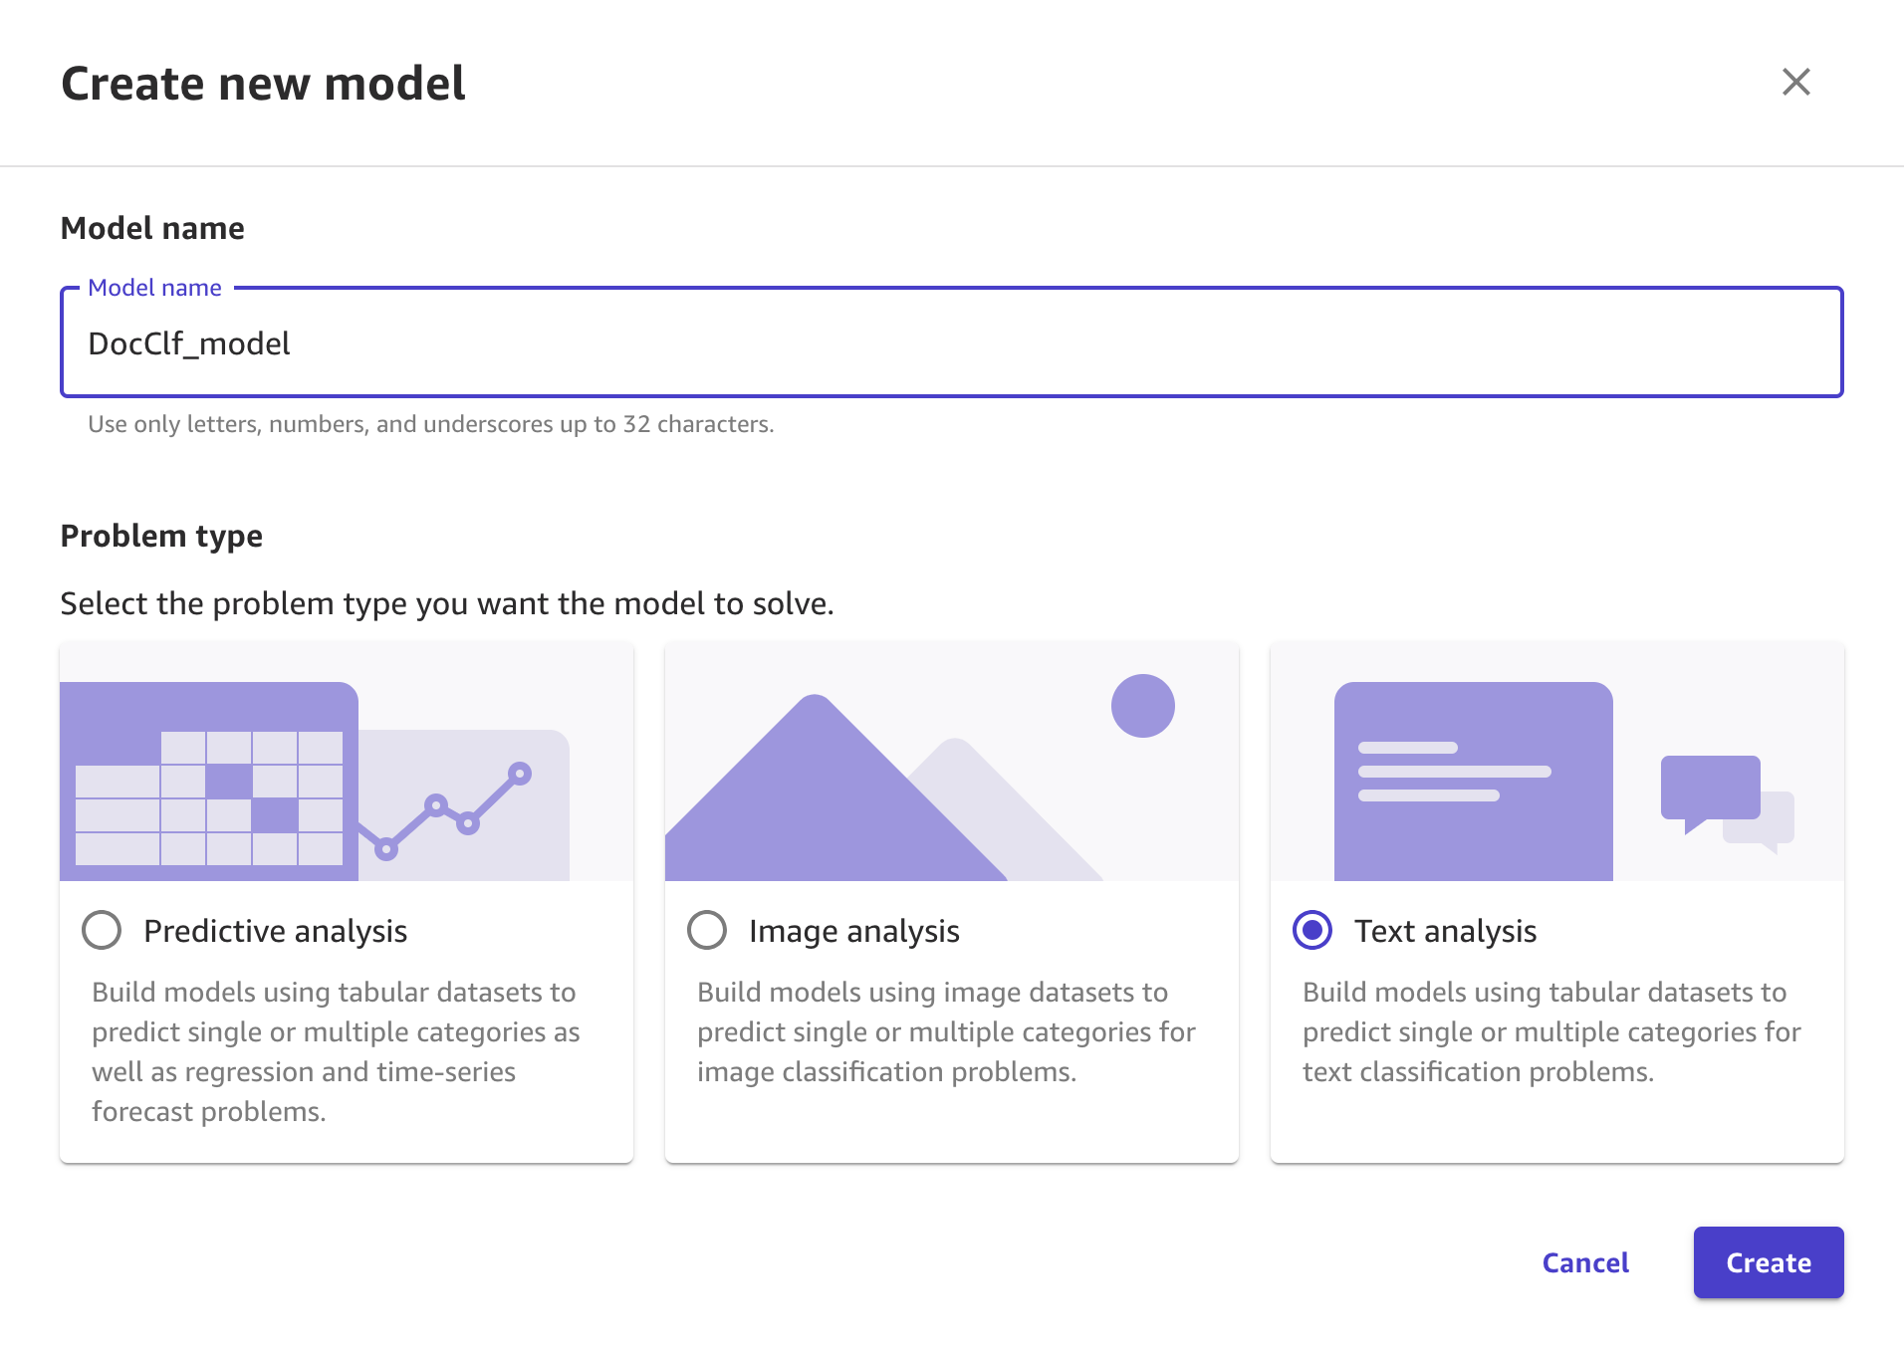
AutoML Solution with AWS SageMaker Canvas
Few clicks to set up the model
Import the data
Training + Validation set
Test set
Select the type of model
Data accepted in a wide array of standard formats

Slide 28
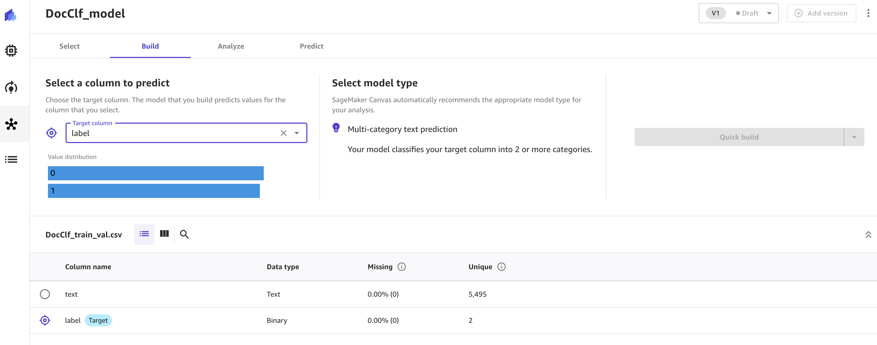
AutoML Solution with AWS SageMaker Canvas
Visualize data
Set up the problem

Slide 29
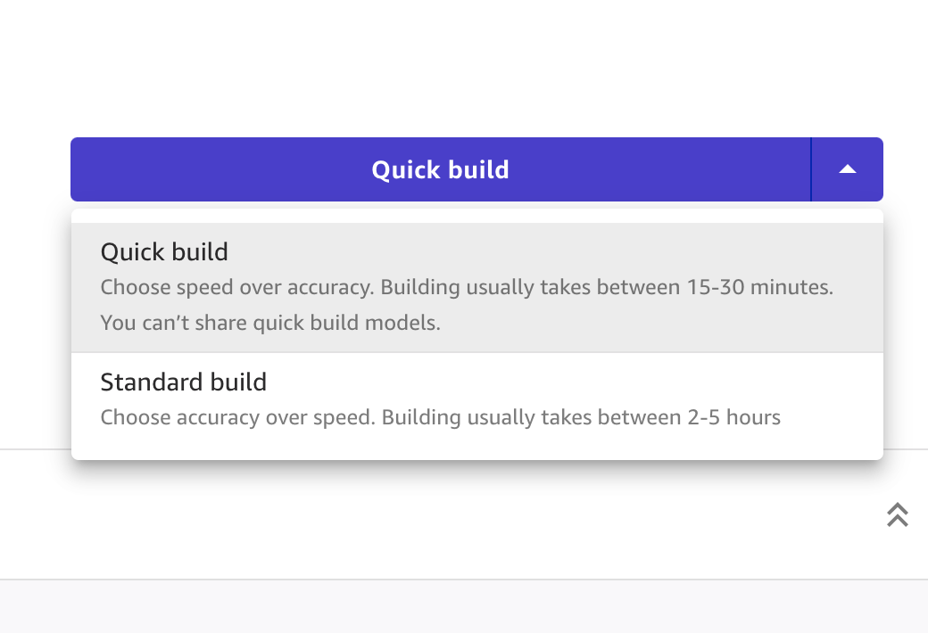
AutoML Solution with AWS SageMaker Canvas
Choose model type.
Quick build: Fast, but lower performance
Quick prototyping
Standard mode: Higher accuracy, slower.

Slide 30
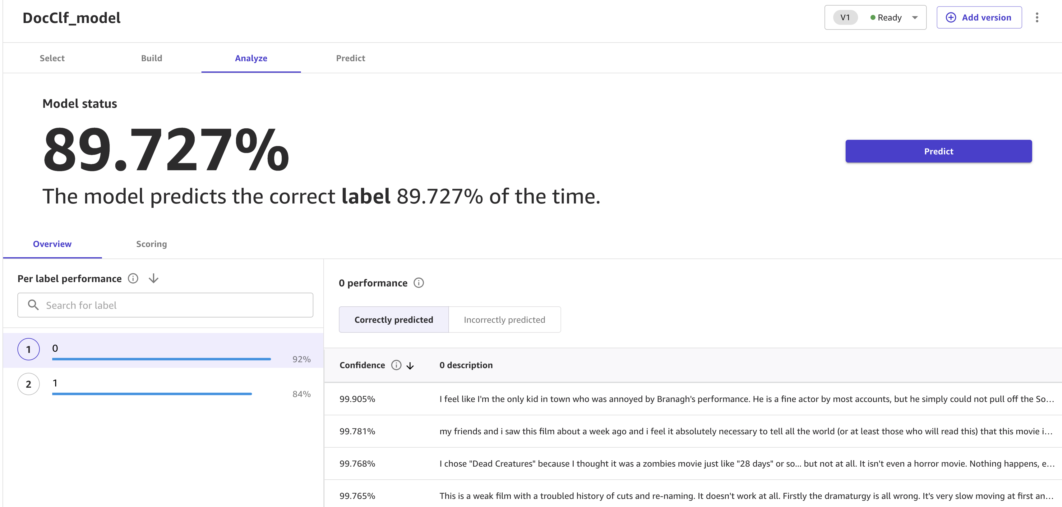
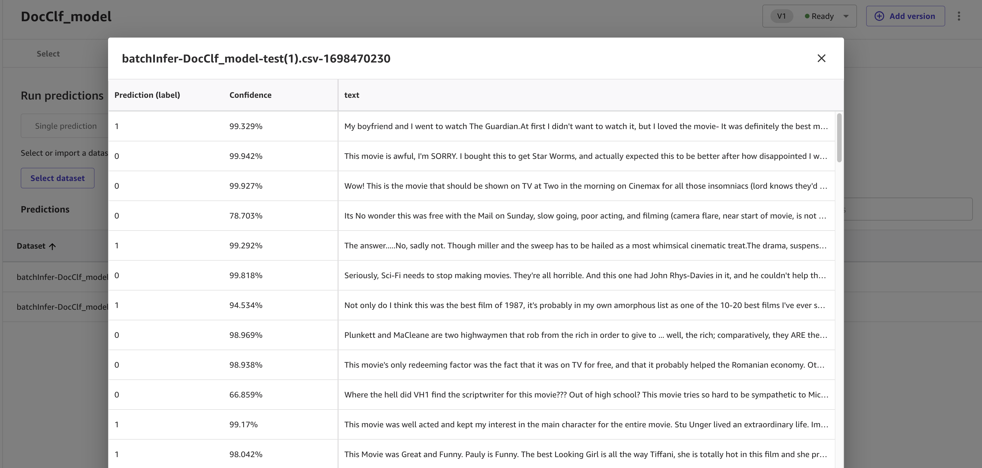
AutoML Solution with AWS SageMaker Canvas

Slide 31
Takeaways
Demonstrate the complexity in
Understanding and setting training metrics and hyper-parameters
In summary, Multimedia researchers might spend effort towards obtaining the correct hyperparameters and might have to invest significant time to obtain knowledge on implementing a solution.
AutoML provides a clean & easy solution.

Slide 32
Conclusion

Slide 33


AWS SageMaker & AutoML
Canvas enables business analysts and data science teams to build their own models without having to write a single line of code.
Multimedia types supported are :
Text
Images
Document Images
AWS SageMaker also provides data preprocessing & manipulation tools that can handle a wide range of datasets.

Slide 34
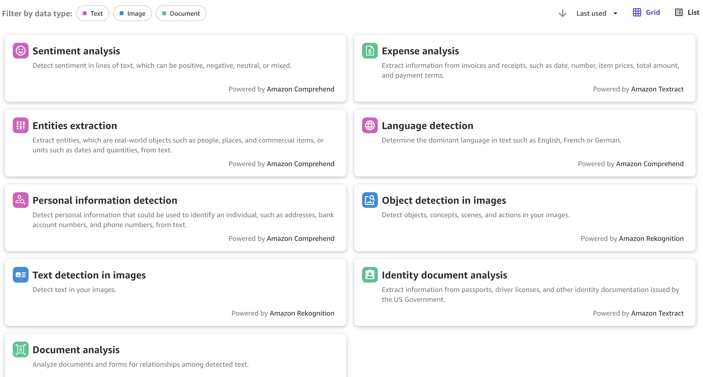
AWS SageMaker Canvas

Slide 35
Conclusion
We demonstrate how AWS Sagemaker provides a comprehensive solution through Canvas & other products
Researchers can utilize ready-made AutoML solutions to achieve research objectives !

Slide 36
Questions
Gerald Friedland
Principal Applied Scientist, AWS
gfriedla@amazon.com
Debanjan Datta
Applied Scientist, AWS
ddebanja@amazon.com

